Slide 1
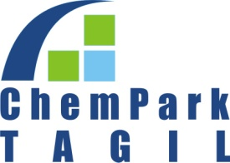
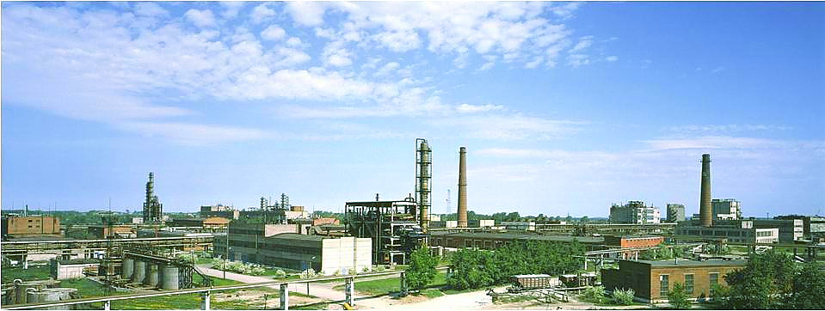
Chemical park Tagil

Slide 2
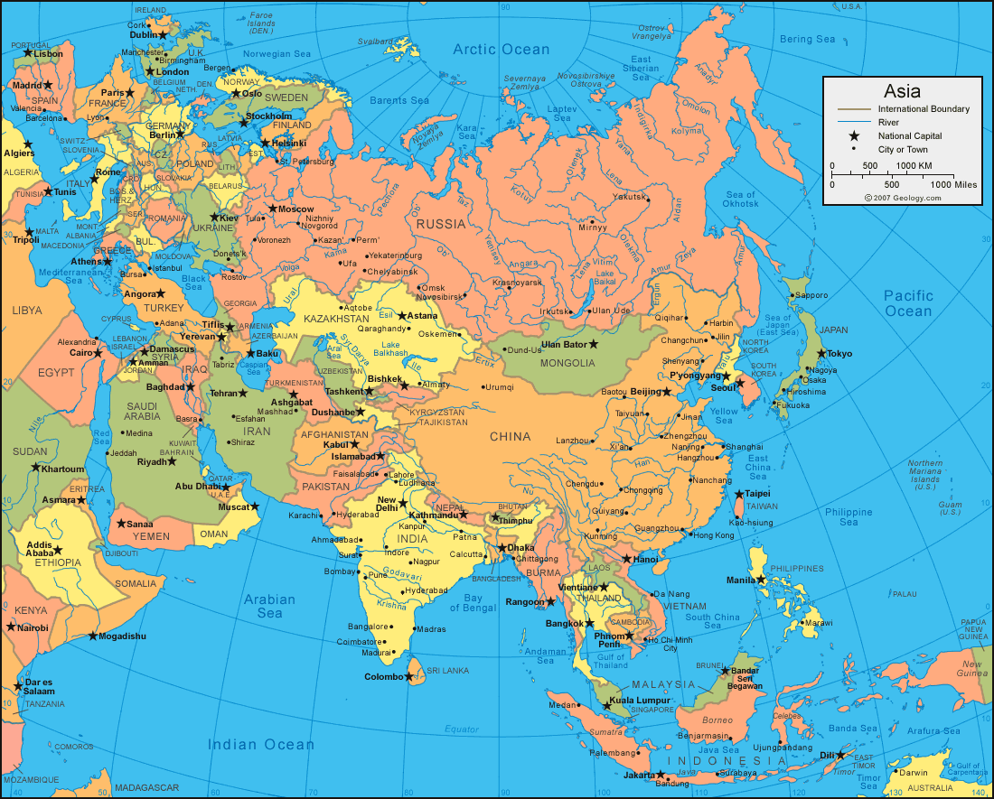
General information
Approximate number of population of Nizhny Tagil – more than 379 ths people.
Main local industries are ferrous metallurgy, machine building, metalworking and chemical industry.
In 146km from Nizhny Tagil the main city and administrative center of Sverdlovsk region – Yekaterinburg is located.
Europe
Chempark
China

Slide 3
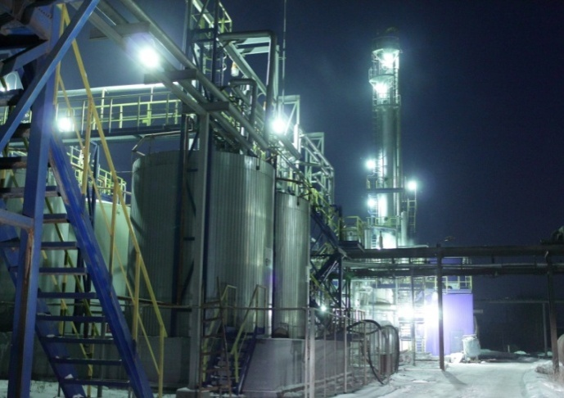
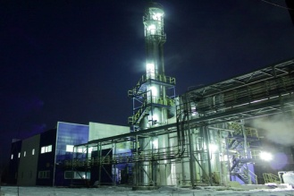
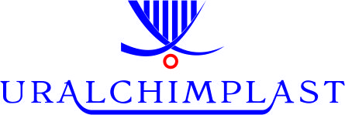
JSC Uralchimplast at a glance
Founded in 1938
The major share-holder is UCP Chemicals AG (Austria) (97.3%)
The largest producer of synthetic resins and plastics in Russia
Annual turnover is more than 100 mln. EUR
Personnel – 1400 employees
Member of EPRA, GPRA, Responsible Care
TUV Certificate

Slide 4
UCP Group’s Corporate Structure
UCP Chemicals AG
Holding Company, Vienna
100%
50%
50%
97,3%
50%
50%
CJSC “Chempark – Tagil”
LLC “Uralchimplast –
Amdor”
JSC “Uralchimpalst”
LLC “Uralchimplast -
Cavenaghi”
LLC “UCP – SI Group”
Chempark Management
Production
of bitumen additives
Production and sales
Foundry resins
Production
Resins for rubber,
abrasives and
friction
50%
50%
50%
CJSC
“UralMethanolGroup”
CJSC “Amdor”
Cavenaghi S.p.A.
SI Group
Methanol Production
50%
50%
Oil and Gas Company
“ITERA”
Branches
LLC “UCP-Kronospan”
Moscow
Saint-Petersburg
Novosibirsk
Togliatti
Rostov-on-Don
Sales of urea resins
50%
LLC “Kronospan”

Slide 5
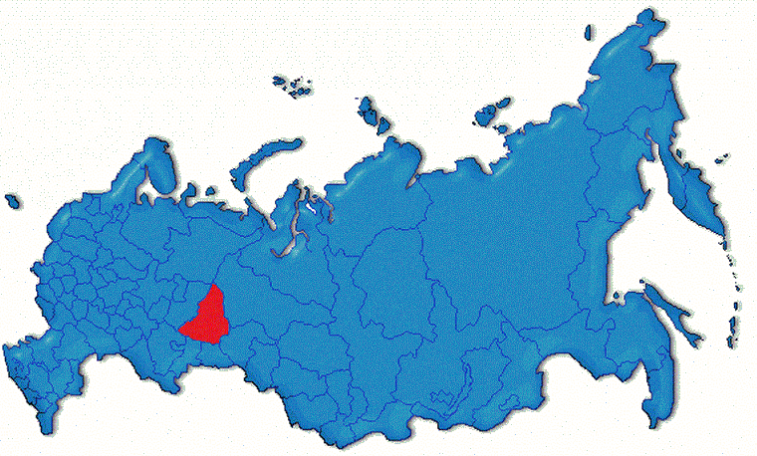
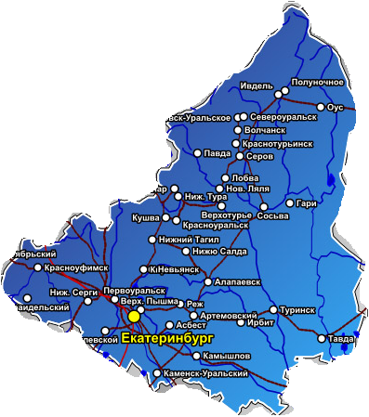
Location of ChemPark Tagil
Area of the site: 146 Ha
ChemPark is located in the north-east part of Nizhny Tagil city in Sverdlovsk region, Russia.
ChemPark TAGIL
Russia
The site is surrounded by several industrial objects: Uralvagonzavod, Metallurgical plant of Nizhny Tagil, Plant of reinforced concrete products, Coke-chemical plant.
Ekaterinburg
Sverdlovsk region

Slide 6
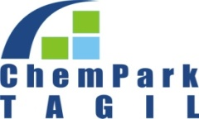
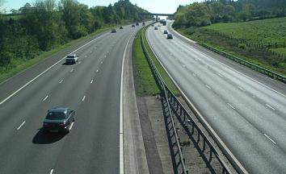
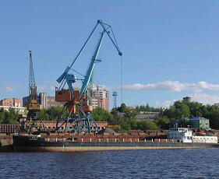
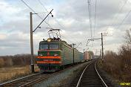
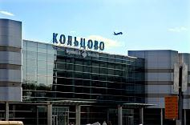
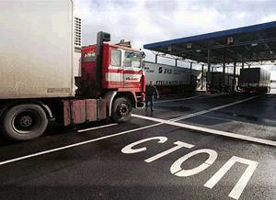
Connections
Road Р353 connecting to Ekaterinburg in 10km
and access to road М5
River harbor in the city of Perm
in 370km from Nizhny Tagil, connecting by road, railway.
Railway station Vagonozavod in 3km
from the site
International airport “Koltzovo” in Ekaterinburg in140km from Nizhny Tagil, connected by road M5
Customs post “Nizhnetagilsky”
in 5km from the site

Slide 7
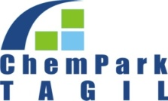
Site characteristic
The site is defined in a cadastral passport as "the land of settlements." Encumbrance of land is not registered.
The site is owned by JSC "Uralchimplast" that a certificate of state registration.
The main type of permitted use - for the operation of the industrial site with rail tracks, which fully corresponds to the current use of the site.

Slide 8
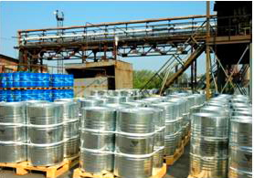
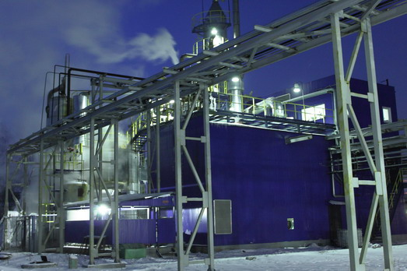
ChemPаrk infrastructure
Available capacities of energy resources
Proper purification and treatment facilities
Industrial garbage landfill
Utilization of chemical contaminated runoffs
On-site network of roads is 35km length
On-site rail road network of 20km length
Logistic services and warehouse facilities for storage of
raw materials and finished products
Pipelines network across the ChemPark site

Slide 9
Available resources
Resources | Available capacity | Free capacity
Natural gas 3 atm | 40 000cbm/h | 25 000cbm/h
Power supply | 82.5mW | 50mW
Heat supply (steam) 4-6 atm, 21 atm | 90Gcal/h | 35Gcal/h
Water supply | 700cbm/h | 300cbm/h
Biological waste water purification and treatment facilities | 5 200cbm/h | 700cbm/h
Nitrogen 3 atm | 250cbm/h | 50-80cbm/h
Compressed air 3 atm | 130cbm/h | 30cbm/h

Slide 10
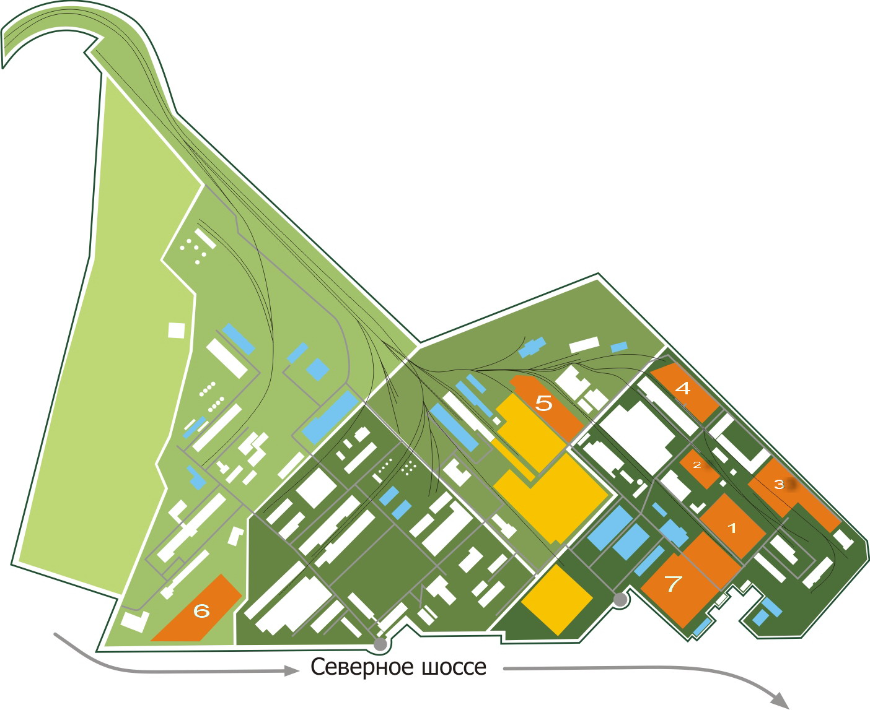
ChemPark Tagil layout
Free sites
Available buildings
Occupied buildings
Severnoe road

Slide 11
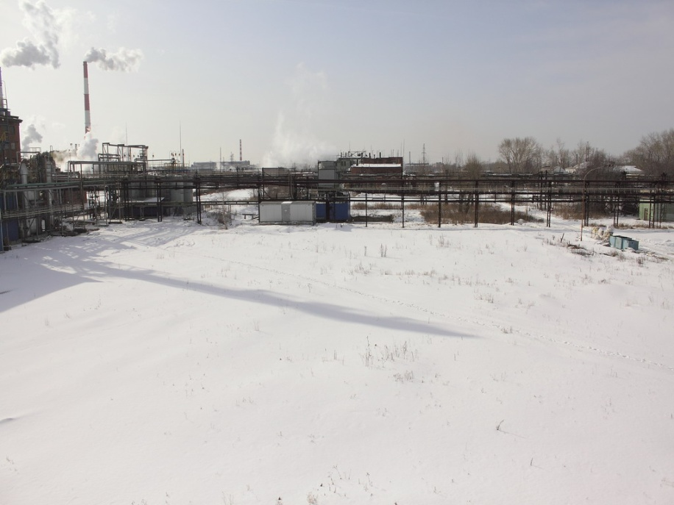
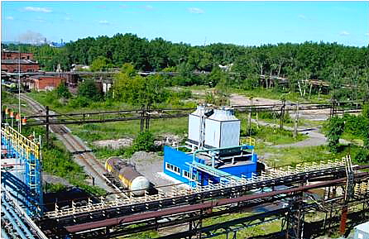
Brief description of the sites
Краткая характеристика площадок
All sites are preliminary prepared for construction
The majority of main utilities routes is located close to proposed sites
Available power resources for connection of new residents
Several possible connection points are available for most of utilities
All sites are provided with transport access
Most of the sites have possibility to enlarge its area

Slide 12
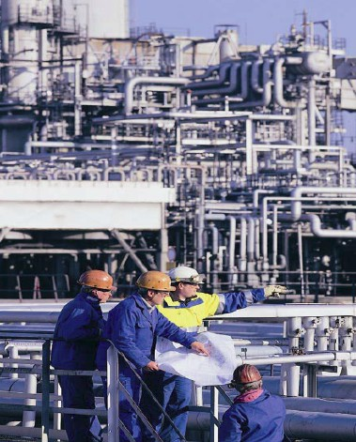
Projects in action
Project
logic
600 Kt/y methanol plant
Total investments 12,4 bln.rub.
Own investments 3,6 bln.rub
Employees 180
Tax increase 1 bln.rub/y
Invested 1 bln.rub.
Turnover increase 6,5 bln.rub.
15 Ha land plot has been bought and prepaired.
OBE contract with italian company Techint for
the estimation of EPC contract has been fulfilled.
Project had completed State expert assessment
expertise.

Slide 13
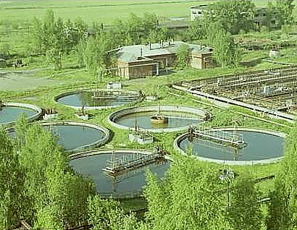
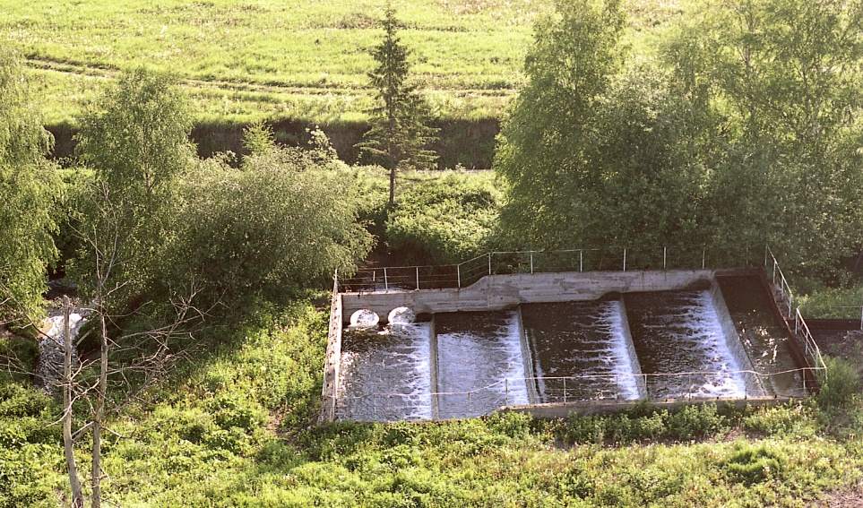
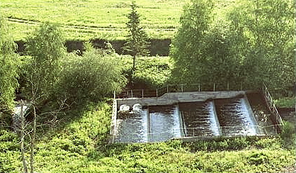
Project is based on the Russian federation government decision that supports mono-cities. - Investments: - Total 556 mln.rub - JSC Uralchimplast 217 mln.rub - State investments 339 mln.rub - Start up April 2012 г. The project will increase the capacity of Waste water treatment facility for 15 000 cubic meters/day that will meet the needs of the ChemPark residents.
Waste water treatment plant of ChemPark Tagil

Slide 14
ChemPark benefits
Full range of services
In the ChemPark residents can focus on their core processes
analytics
utilities
Environmental services
Safety and security
Legal services
ChemPark support
Core processes
Research/
development
marketing
Production
sales
customers
Medical services
maintenance
PR
infrastructure
Site security
ChemPark support

Slide 15
Thank you for your attention!

